Slide 1
Open for Good:
Strategic Support for OER at the
University of Edinburgh
Stephanie Charlie Farley | May 2025

Slide 2
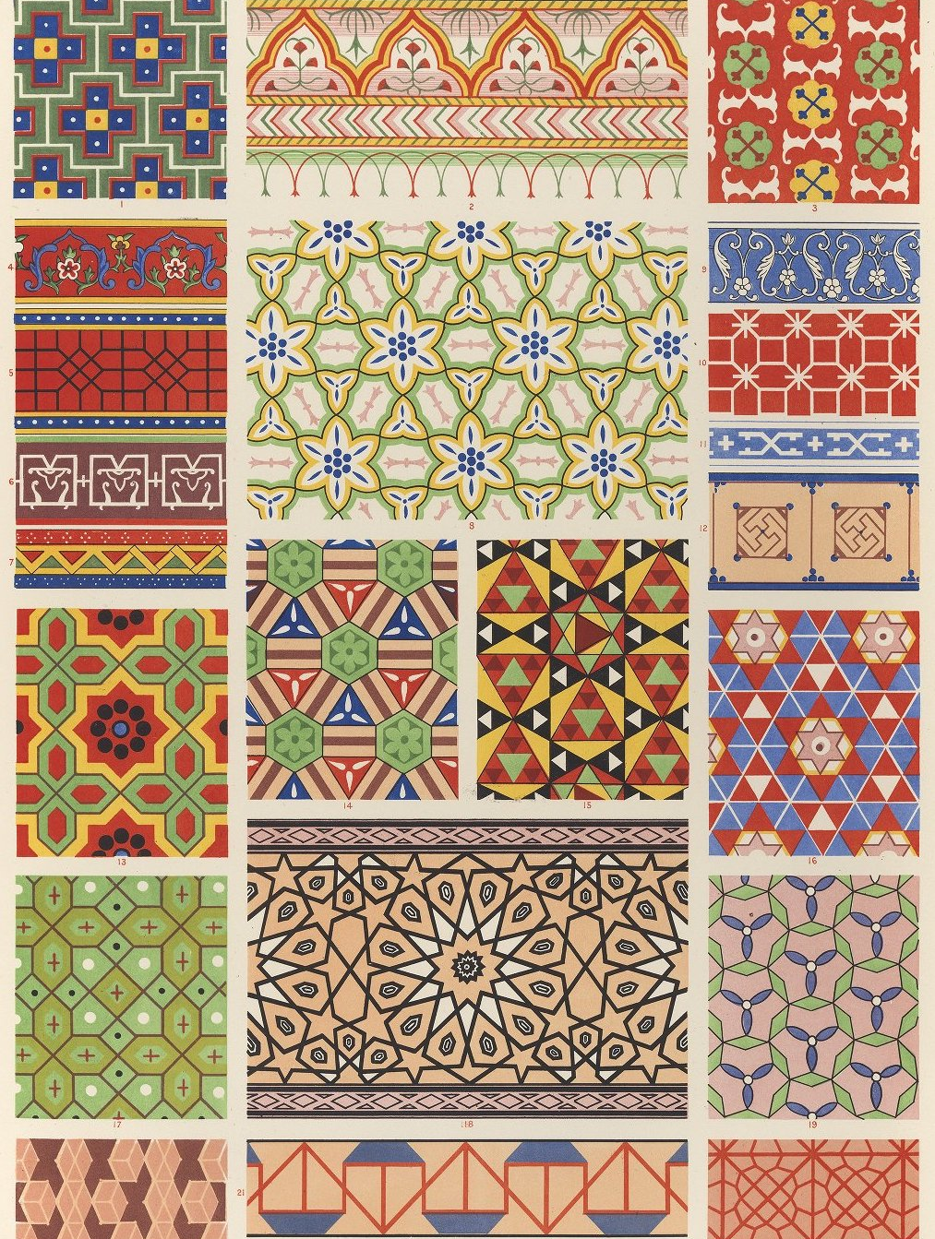
Overview
University of Edinburgh OER vision & policy
Copyright debt
Strategic support for open education & OER
Transforming the curriculum with OER
  GeoScience Outreach
  Digital Futures for Learning
Recommendations
The Grammar of Ornament, pl.XLV, CC BY NC SA, University of Edinburgh Library

Slide 3

University of Edinburgh Vision
Our graduates, and the knowledge we discover with our partners, make the world a better place.
Our teaching and research is relevant to society and we are diverse, inclusive and accessible to all.
Commission from the Dodge of Venice, Recto, CC BY-NC-SA 2.0, University of Edinburgh.
Notes:
Here at the University of Edinburgh, we believe that open education and the creation of open knowledge and open educational resources, are in keeping with our institutional vision, purpose and values, as we seek for our graduates, and the knowledge we discover with our partners, to make the world a better place. And that our teaching and research is relevant to society and we are diverse, inclusive and accessible to all.
Our student union were instrumental in encouraging the University to support OER, and we continue to see student engagement and co-creation as being fundamental aspects of open education.

Slide 4

Our Vision for OER
- For the Common Good
Teaching and learning materials exchange to enrich the University and the sector.
To put in place the support frameworks to enable any member of University of Edinburgh to publish and share online as OER teaching and learning materials they have created as a routine part of their work at the University.
To support members of University of Edinburgh to find and use high quality teaching materials developed within and without the University.
Streetlamp: Detail Castle, Cover image for ‘We have great stuff’ colouring book volume 2,
CC BY 4.0, University of Edinburgh.
Notes:
The University’s vision for OER is very much the brain child of Dr Melissa Highton, Assistant Principal Online Learning and Director of Learning and Teaching Web Services. Our vision for OER has three strands:

Slide 5

Our Vision for OER
- Edinburgh at its best
Showcasing openly the highest quality learning and teaching.
To identify collections of hig- quality learning materials within each school department and research institute to be published online for flexible use, to be made available to learners and teachers as open courseware (e.g. recorded high profile events, noteworthy lectures, MOOC and DEI course content).
To enable the discovery of these materials in a way that ensures that our University’s reputation is enhanced.
Detail from ‘Setting Up Your Camera and Equipment’ video,
How to Create Video for Online Courses MOOC,
CC BY 4.0, University of Edinburgh.

Slide 6
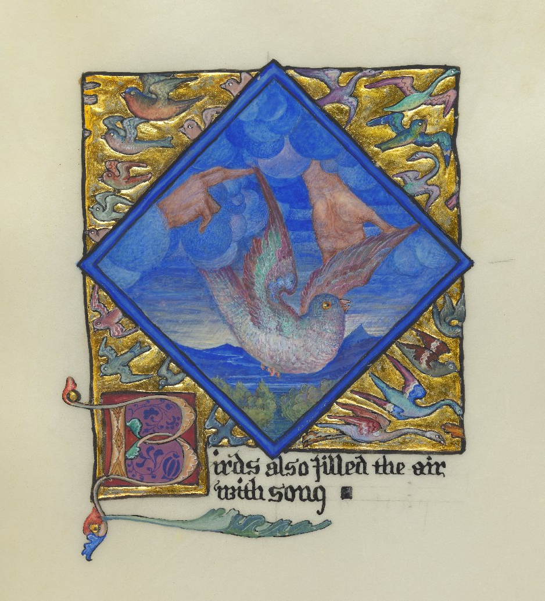
Our Vision for OER
- Edinburgh’s Treasures
Making available online a significant collection of unique learning materials available openly to Scotland, the UK and the world, promoting health and economic and cultural well-being.
To identify a number of major collections of interdisciplinary materials, archives, treasures, museum resources to be digitised, curated and shared for the greater good and significant contribution to public engagement with learning, study and research.
To put in place policy and infrastructure to ensure that these OER collections are sustainable and usable in the medium to longer term.
Song School St. Mary, 1897,
Phoebe Anna Traquair Collection,
CC BY 4.0, University of Edinburgh.

Slide 7
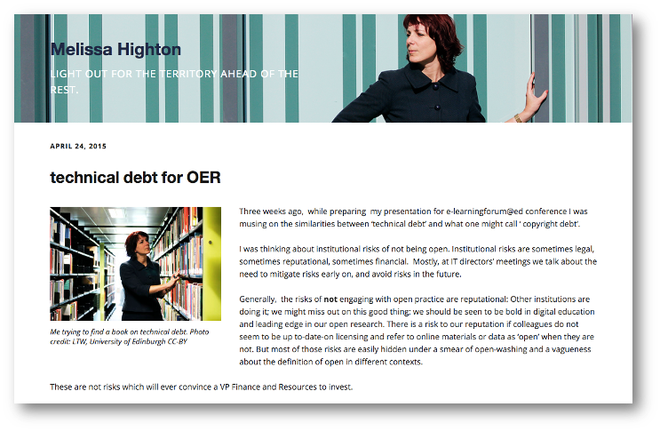
Copyright Debt
Copyright Debt, https://thinking.is.ed.ac.uk/melissa/tag/copyright-debt/
Notes:
Another backbone of our strategic practice is the concept of copyright debt: Coined by Dr Melissa Highton.
From the moment a colleague tells you that they don’t have time, or don’t care about the copyright licensing and metadata on their teaching materials and load them up into a VLE, online course environment, departmental website, online course-pack, lecture power-point slides, whatever, you start to accrue ‘copyright debt’. The cost will hit at the moment that you migrate from one VLE to another, or from one website to another, or from one media asset management system to another.

Slide 8

OER Policy
Approved by Learning and Teaching Committee in January 2016, updated 2021, and undergoing review in 2025.
Informative and permissive.
Encourages staff and students to use, create and publish OERs to enhance the quality of the student experience.
Helps colleagues make informed decisions about creating and using OER.
Prodromus Dissertationum Cosmographicarum, f.p.24, CC BY-NC-SA 2.0, University of Edinburgh.
Notes:
Tying all of this together Our Open Educational Resources Policy to support open education and the creation and use of OER, was first approved by our Education Committee in 2016, updated in 2021, and is undergoing another review in 2025.
It’s important to be aware that our OER Policy is informative and permissive. Some universities mandate that any resource considered for internal teaching awards must be open licensed. While we encourage all colleagues to share their resources under open licence, and the sponsors of awards to consider OERs in their award criteria, we didn’t enshrine this in policy.

Slide 9

Open Policies for Learning & Teaching
Accessible and Inclusive Learning Policy
Lecture Recording Policy
Open Educational Resources Policy
Virtual Classroom Policy
Digital Citizenship Guide
Learning Analytics Principles and Purposes
https://open.ed.ac.uk/open-policy-for-learning-and-teaching/
Notes:
Our 2021 update brought the OER Policy in line with our Lecture Recording Policy and Virtual Classroom Policy. With the increase in media being recorded, knowledge of data protection has become essential when creating and sharing open content. The policy clarifies what personally identifiable information colleagues should be aware of when creating open resources, including names, images, voices and personal opinions of individuals. (You can read and re-use our open policies for learning and teaching)

Slide 10
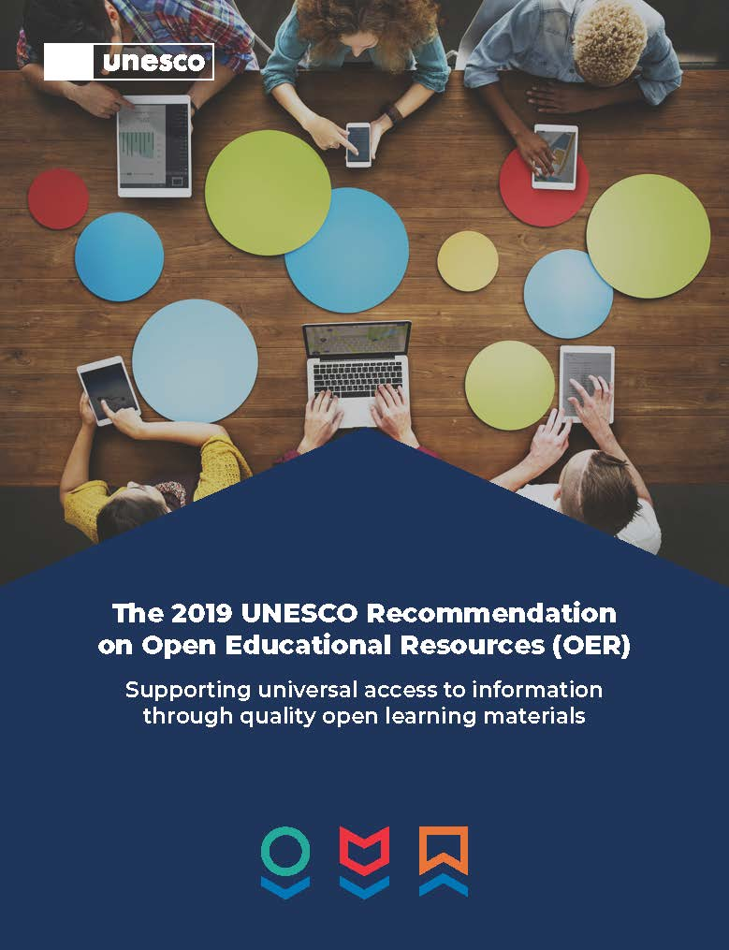
UNESCO Recommendation on OER
“Open Educational Resources (OER) are learning, teaching and research materials in any format and medium that reside in the public domain or are under copyright that have been released under an open license, that permit no-cost access, re-use, re-purpose, adaptation and redistribution by others.”
UNESCO Recommendation on OER, CC BY-SA 3.0, UNESCO.
Notes:
The 2021 update of our policy adopted the 2019 UNESCO Recommendation on OER:

Slide 11

UN Sustainable Development Goal 4
United Nations Global Goals, https://www.globalgoals.org/goals/4-quality-education
Notes:
Central to the Recommendation, is the acknowledgement of the role that OER can play in achieving the 2030 Agenda for Sustainable Development and particularly Sustainable Development Goal 4: to ensure inclusive and equitable quality education and promote lifelong learning opportunities for all.
this reiterates our commitment to openness and achieving the aims of the United Nations Sustainable Development Goals, which the University is committed to through the SDG Accord.

Slide 12
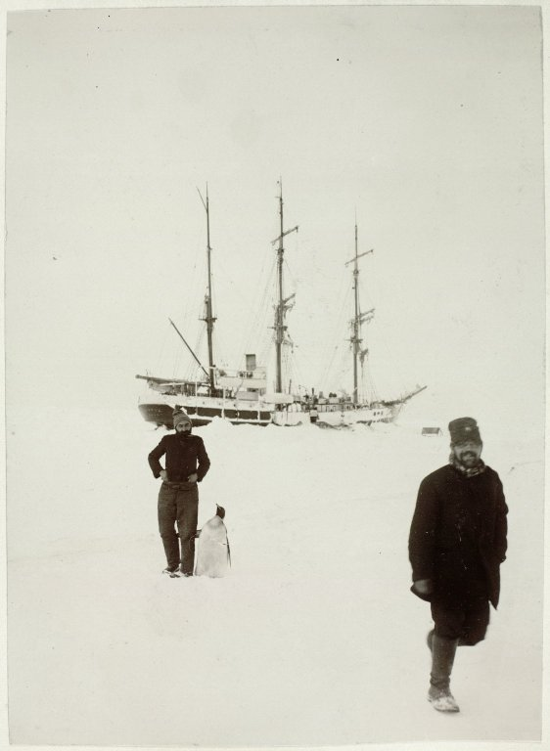
OER Service
Provide advice and guidance on OER and open education.
Run digital skills programme on digital and copyright literacy.
Support open education in the curriculum.
Work closely with Online Course Production Service and Wikimedian in Residence.
Papers of William Speirs Bruce, No.686, CC BY-NC-SA 2.0, University of Edinburgh.
Notes:
Along with the OER Policy In 2016 the University launched an OER Service, based in Information Services Group Next year we’ll be celebrating 10 years of both our policy, the OER Service, and the many ways that open has benefited our staff and students.
The service provides staff and students with advice and guidance on creating and using OER and engaging with open education. We offer support directly to Schools and Colleges, and employ student interns in a range of different roles, including Open Content Curation interns.

Slide 13
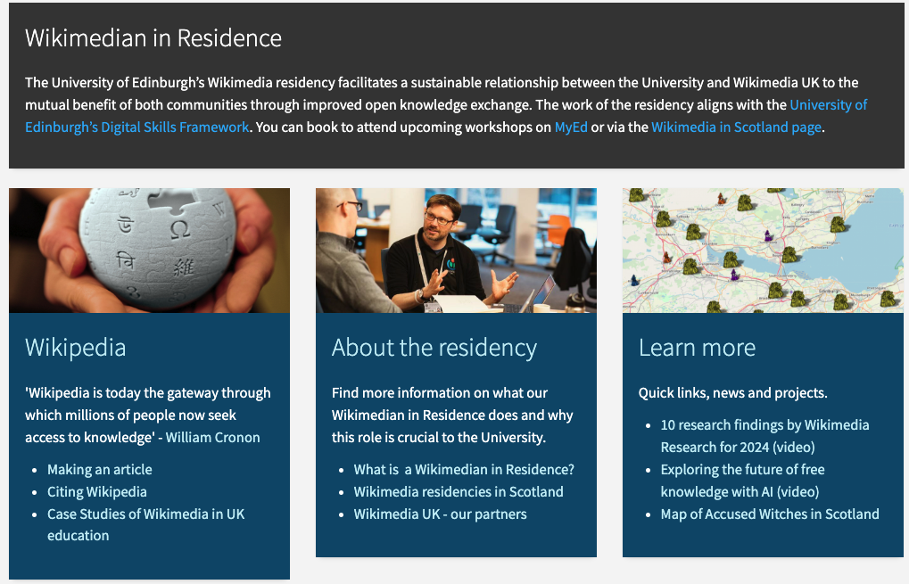
Wikimedian in Residence
https://information-services.ed.ac.uk/help-consultancy/is-skills/Wikimedia
Notes:
We also work closely with our Wikimedian in Residence.

Slide 14
University of Edinburgh
Principal & Vice-Chancellor
College of Arts, Humanities and Social Sciences
College of Medicine and Veterinary Medicine
College of Science and Engineering
Information Services Group
Chief Information Officer, Librarian to the University
Corporate Services Group
University Secretary’s Group
Finance Directorate
User Services Division
Applications Dev. & Operations
ISG Corporate
IT Infrastructure
Learning, Teaching & Web
Assistant Principal Online Learning
Digital Curation Centre
EDINA
Information Security
Library & Collections
Edinburgh Diamond
Digital Skills, Design & Training
Educational Design & Engagement
Learning Spaces Technology
Digital Learning Applications
& Media
Website & Communications
OER & Educational Policy Team
Wikimedian in Residence
Design Team
Training Team
Learning Applications Team
Interactive Content Team
Media Team
Technology Enhanced Learning Services
Media Hopper Create
Academic Blogging Service
Learning Design Service
Online Learning Marketing Team
Online Course Production Service
Programme Management & Media Team
Learning & Teaching Technologies Service
Notes:
The OER Service both supports and is supported by a range of central services. Here is the structure of our information Services group, highlighting the services and teams we interact with on a regular basis. We provide training and support to colleagues across our Information Services Group – shown here – and to learning technology, professional, research, and teaching staff across the university.

Slide 15
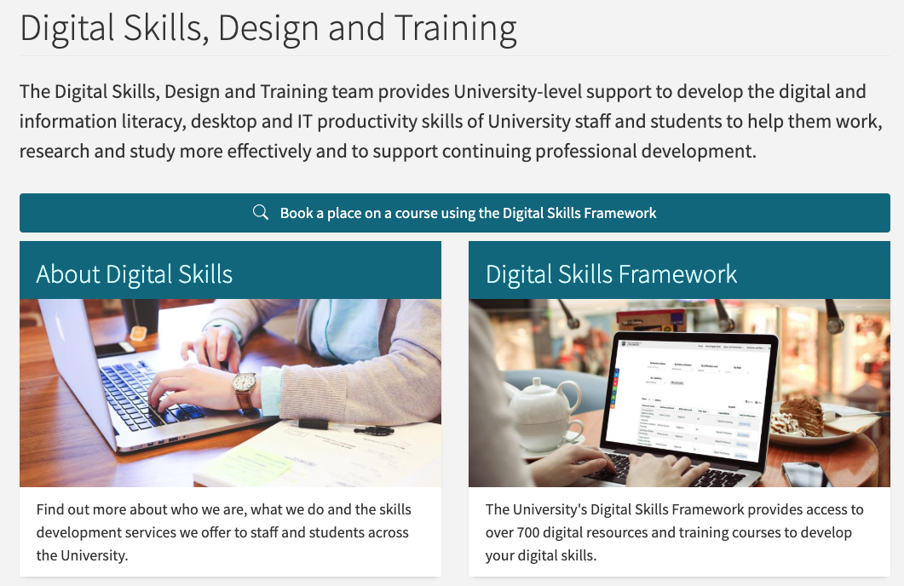
In the Open together
Notes:
and the OER Service’s digital skills programme helps to increase understanding of the benefits of using and creating OERs, encouraging open practice, and improving copyright literacy among both staff and students.

Slide 16
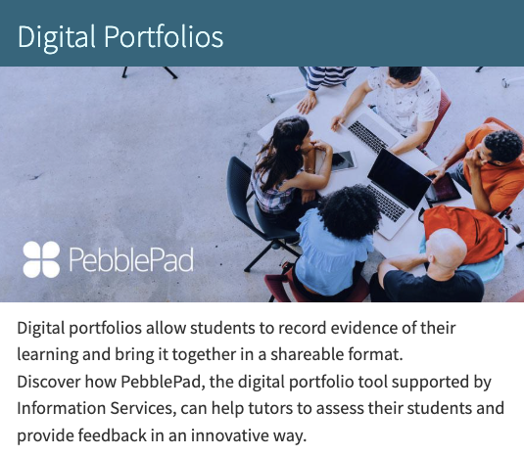
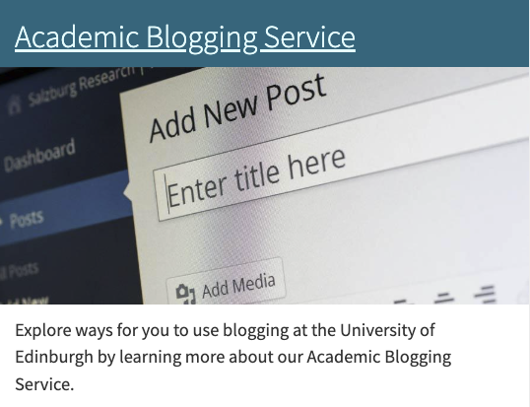
In the Open together
Notes:
Open education, practice, and resources are embedded in our learning technologies and services

Slide 17
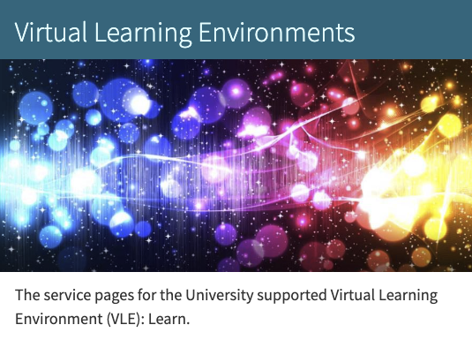
In the Open together
Notes:
The OER Service also places openness at the centre of the university’s strategic learning technology initiatives including lecture recording, academic blogging, VLE foundations, MOOCs and distance learning at scale, in order to build sustainability and minimise the risk of copyright debt.

Slide 18
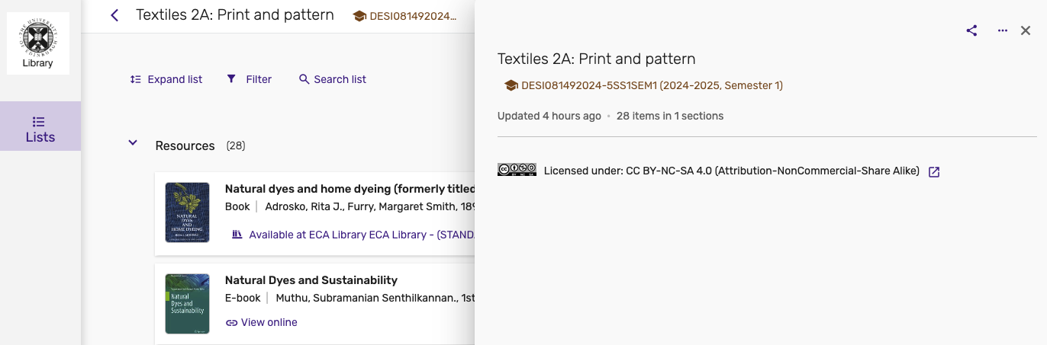
In the Open together
Notes:
Our resource/reading lists are openly viewable and open licensed,

Slide 19

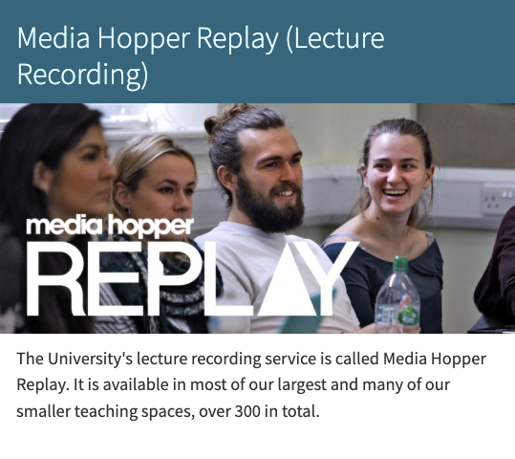
In the Open together
Notes:
Our media technologies and management system teams integrate open licenses and practices,

Slide 20
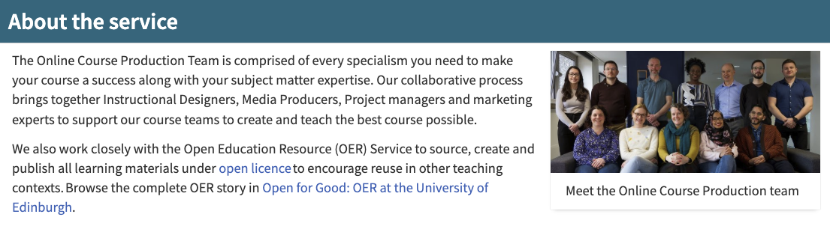
In the Open together
Notes:
The OER Service also works very closely with our Online Course Production teams. While some institutions require that any resource produced in cooperation with the central learning technology service must be open by default, although we don’t mandate this, it is often the case in practice here at the University of Edinburgh;

Slide 21
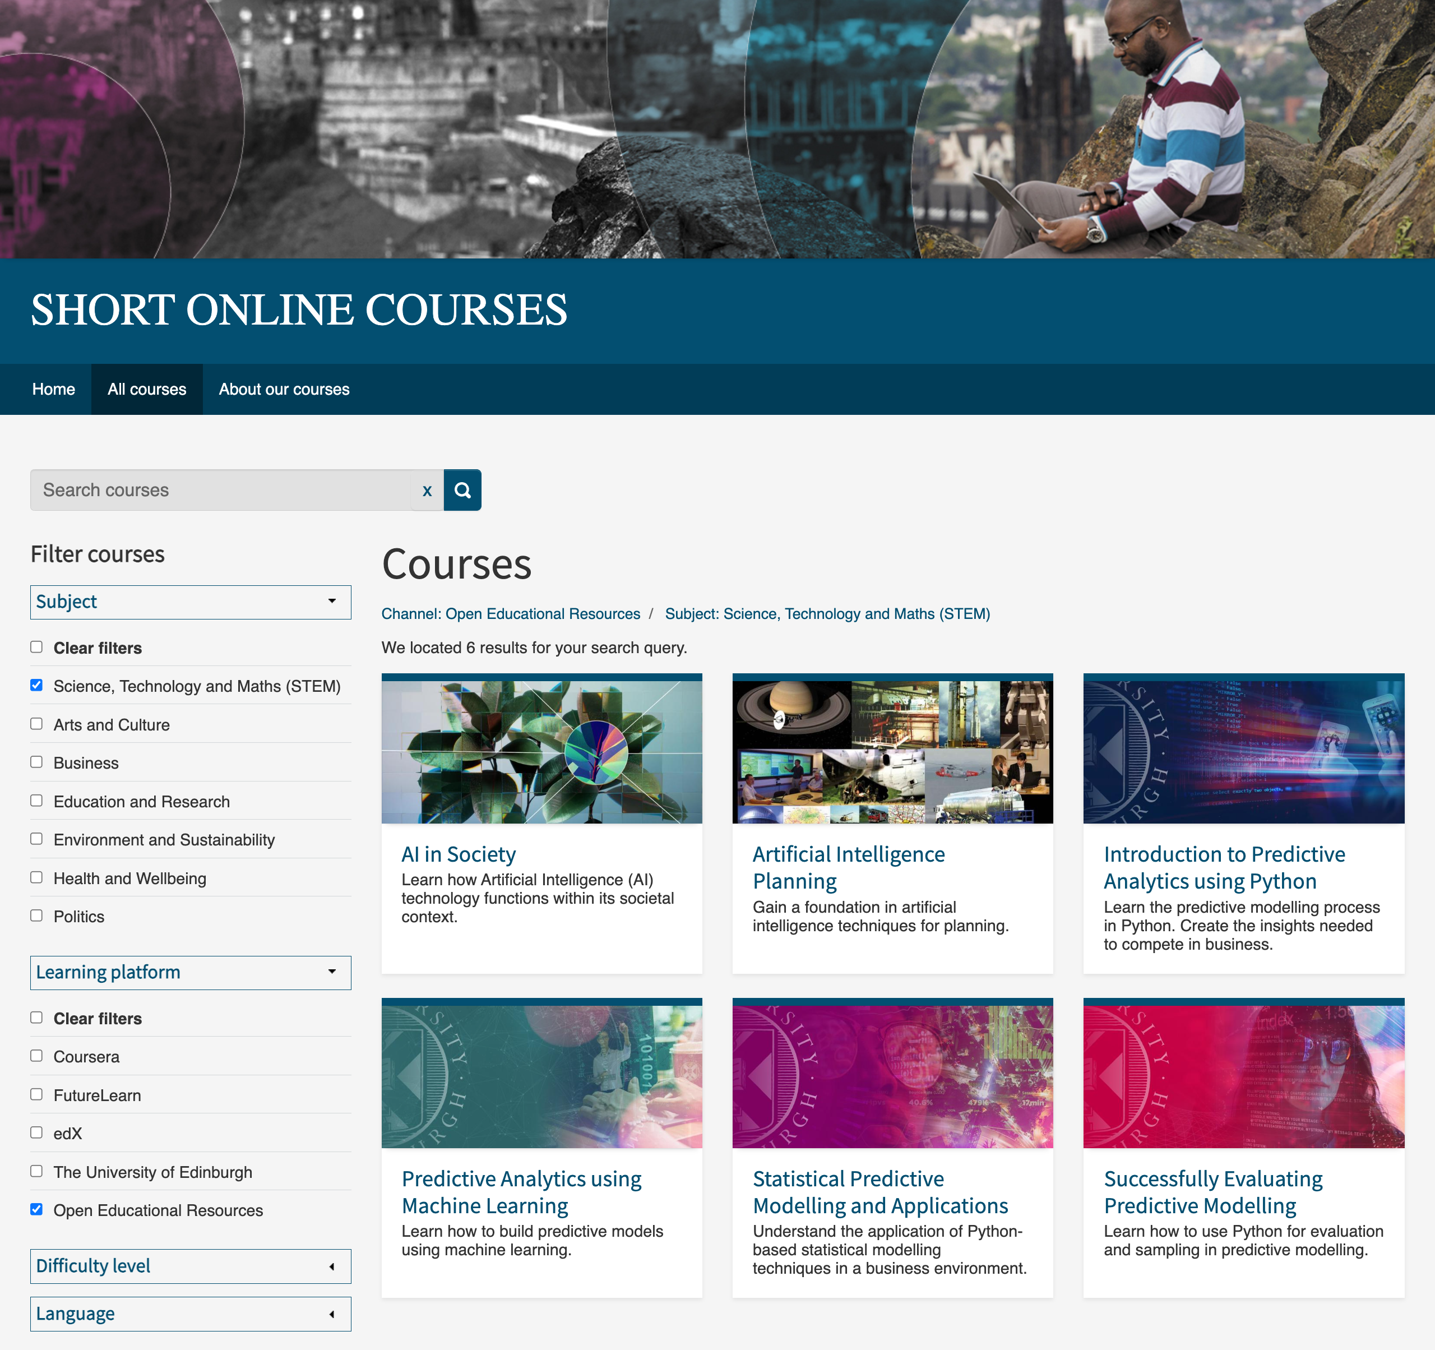
Short Online Courses
https://www.onlinecourses.ed.ac.uk/
Notes:
the majority of the teaching and learning resources created with support from the Online Course Production Service for our free short online courses and

Slide 22
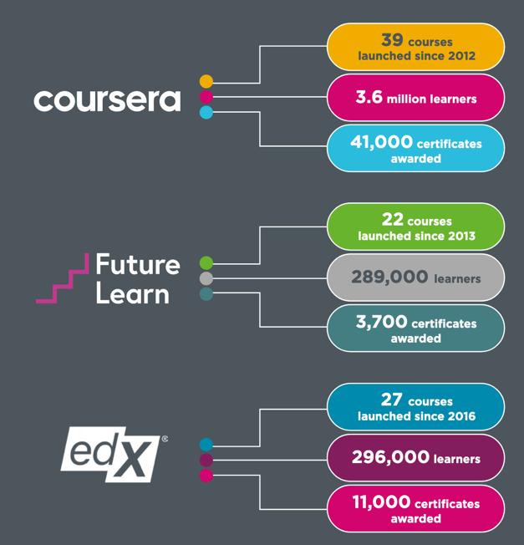
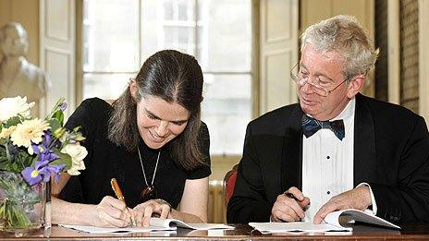
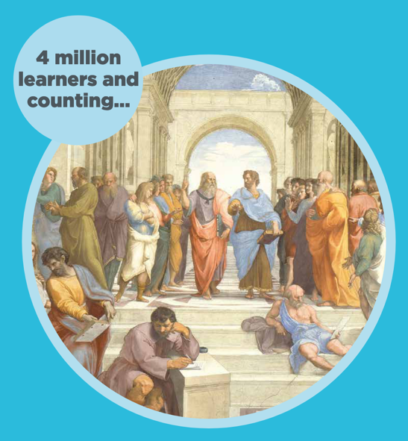
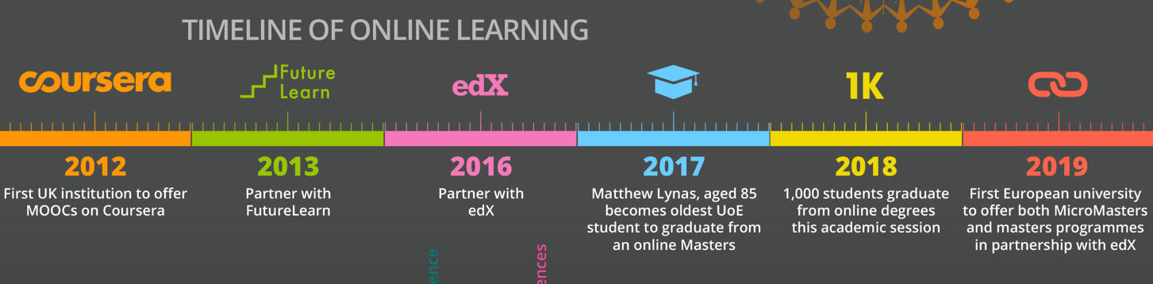
Edinburgh MOOCs: a story
Notes:
Resources created for MOOCs in collaboration with our Online Course Production Service,

Slide 23

Open Media Bank https://media.ed.ac.uk/channel/Open%2BMedia%2BBank/
Notes:
are open licensed and are available on Media Hopper Create. - Our Kultura media platform.

Slide 24
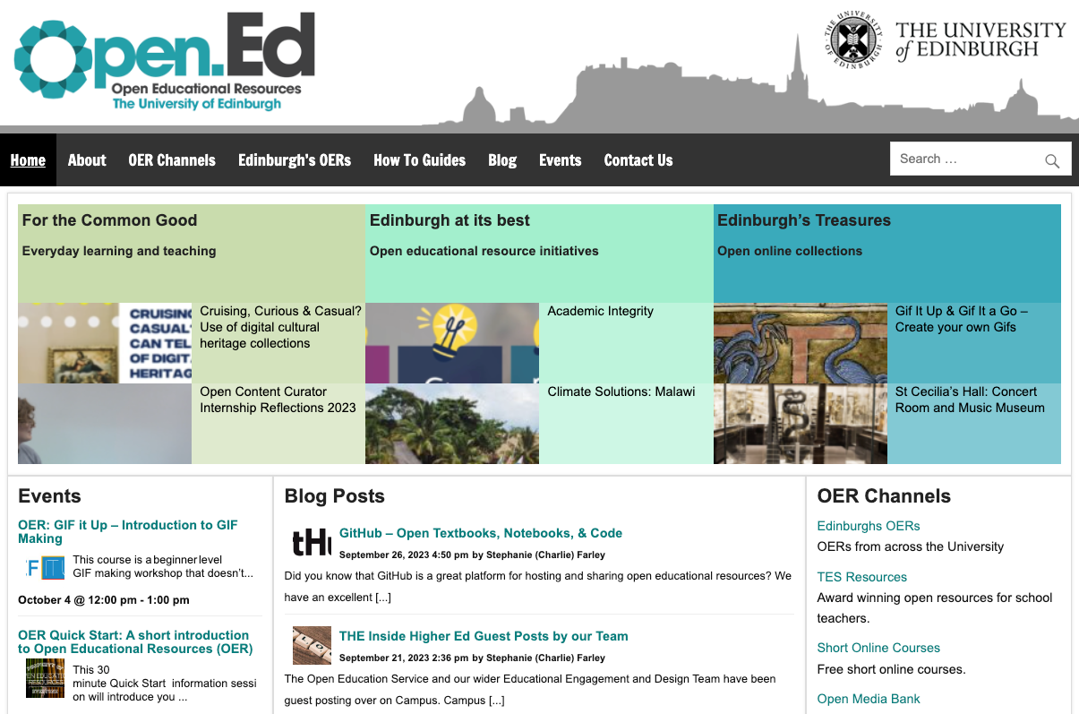
https://open.ed.ac.uk/
Notes:
The OER Service also runs Open.Ed a one stop shop that provides access to open educational resources produced by staff and students across the university.

Slide 25
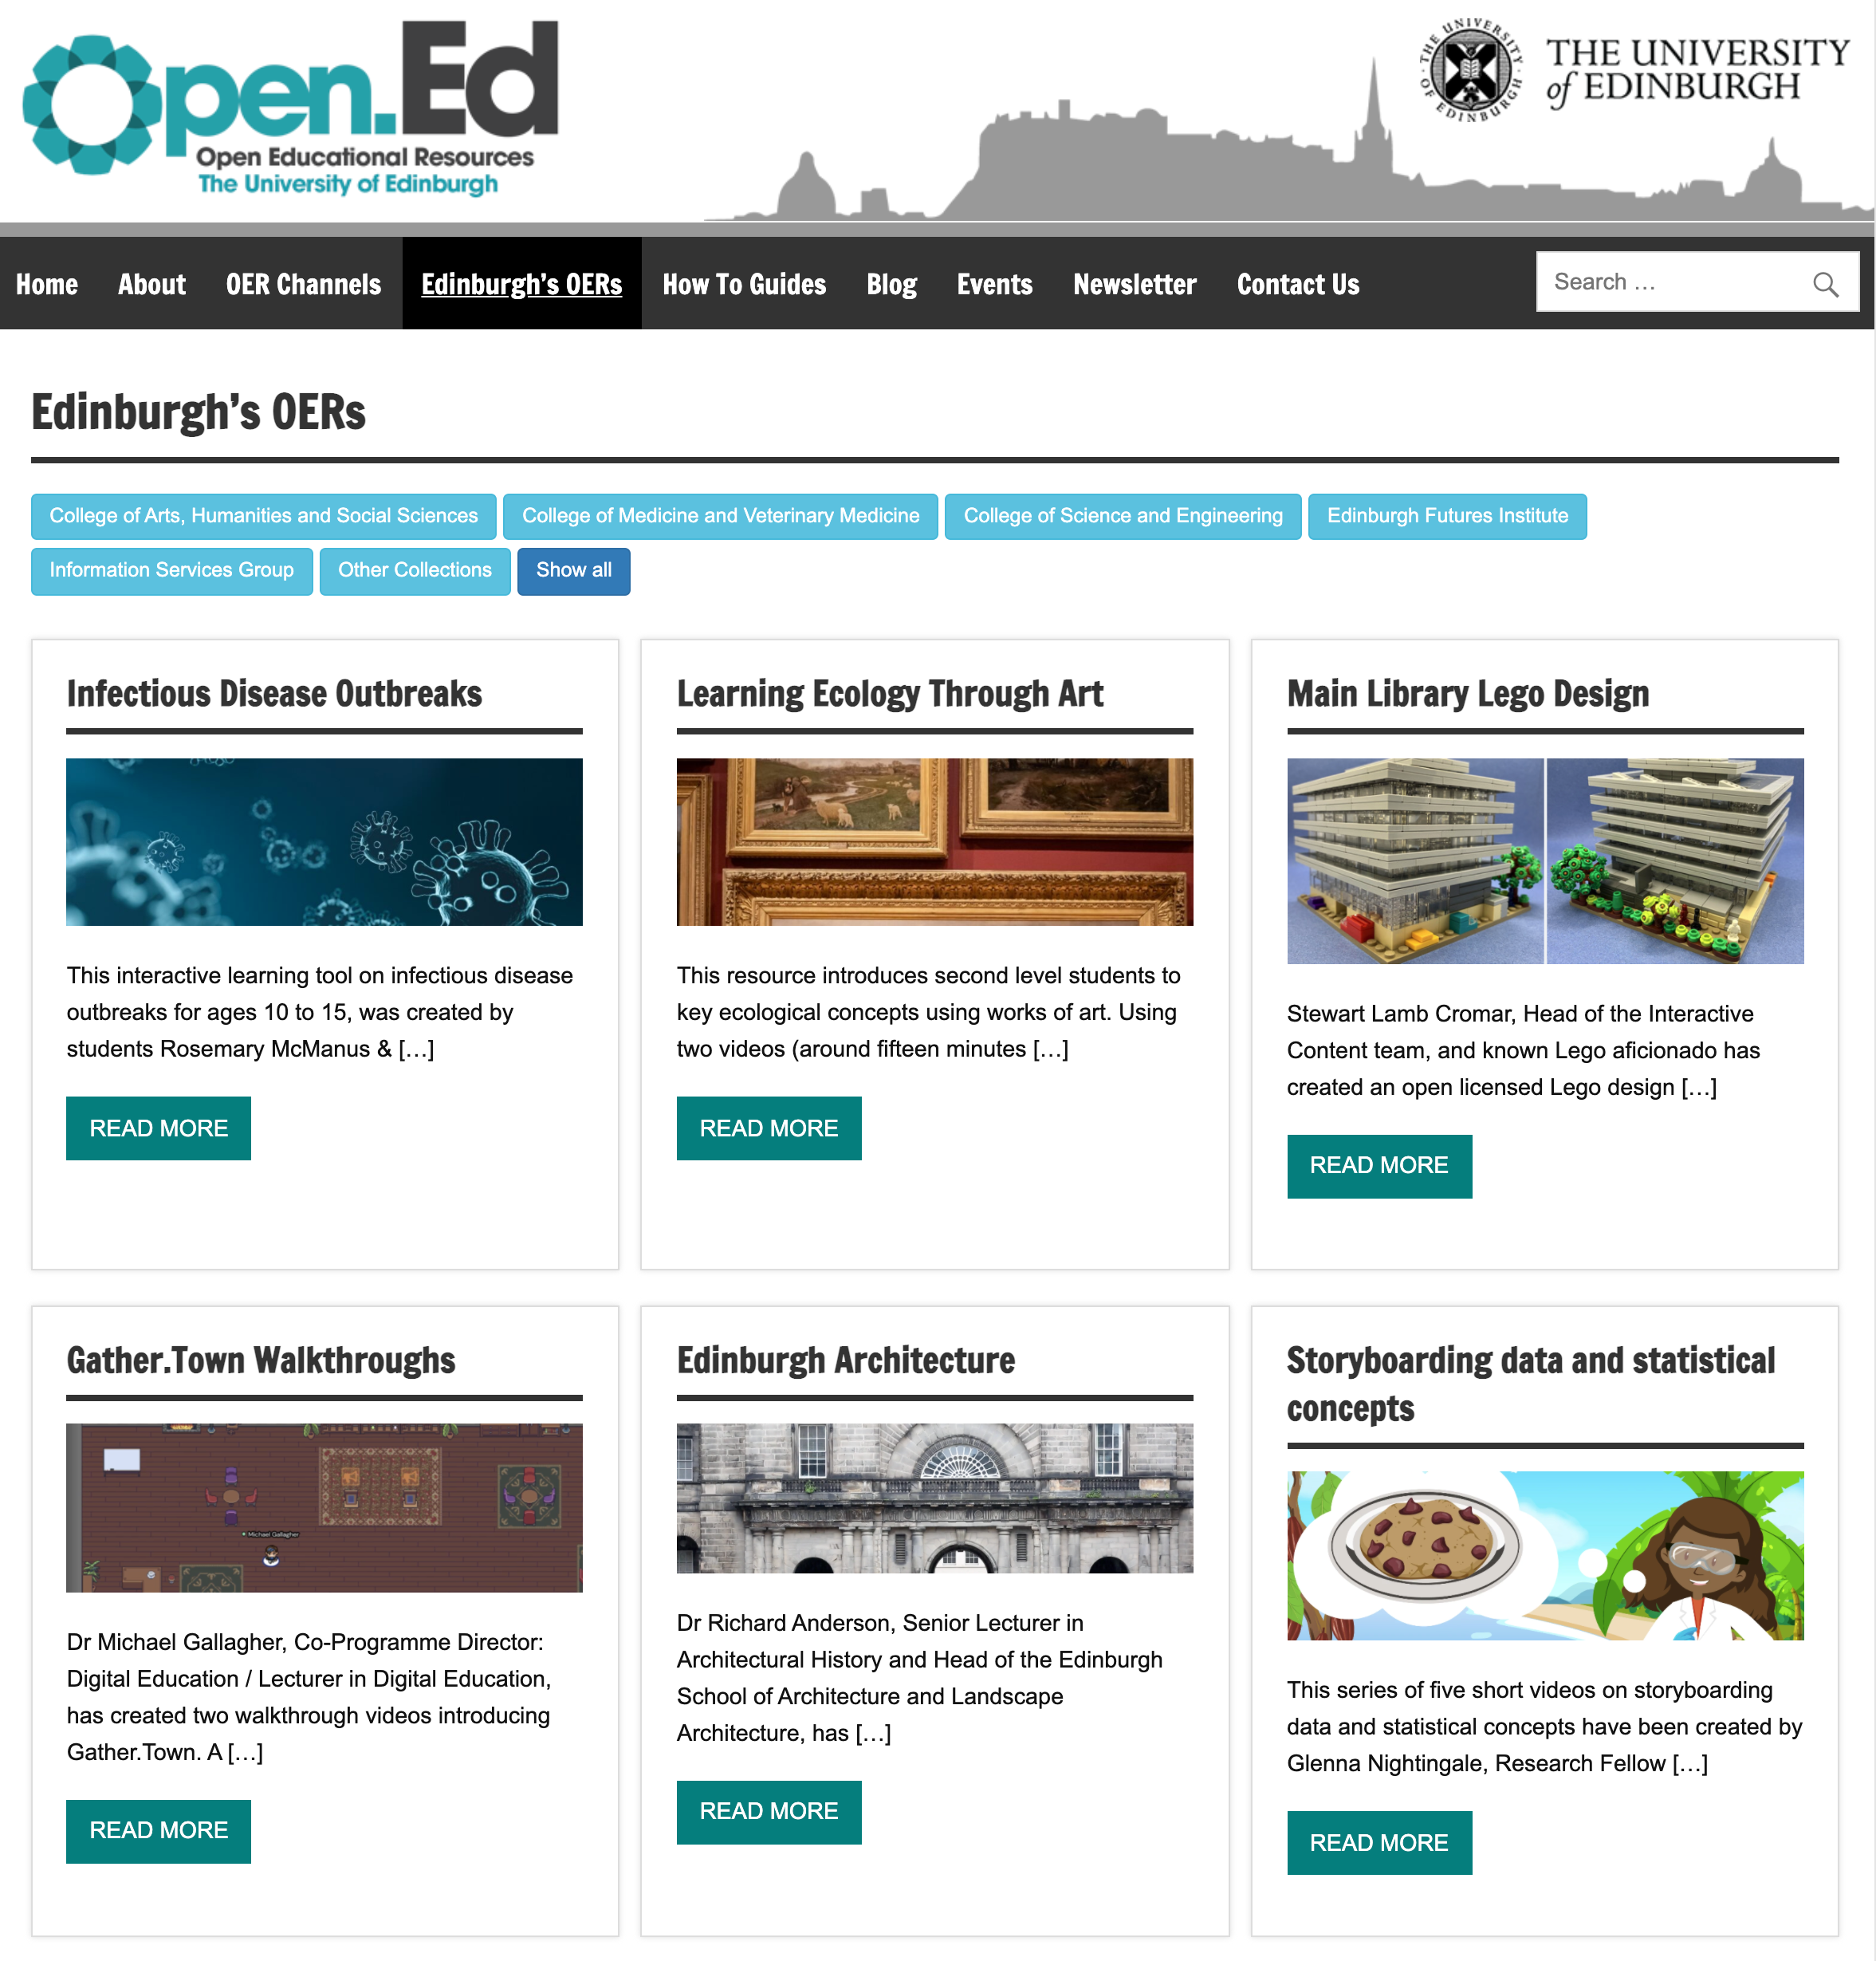
Edinburgh’s OERs https://open.ed.ac.uk/edinburghs-oers/
Notes:
Here at the University we trust colleagues to quality control their own teaching and learning resources, and we do not have a central OER repository because they are often unsustainable, and it can be difficult to encourage engagement. Instead, the Policy continues to encourage colleagues to share their open licensed teaching and learning materials in an appropriate repository or public-access website so that they can be discovered and re-used by others.

Slide 26








Notes:
The OER Service provides access to many channels for this purpose on both University and commercial services, and we aggregate a show case of Edinburgh’s OERs on the Open.Ed website.
We don’t have is a formal peer review system for open educational resources. The review process that different materials will undergo will depend on the nature of the resources themselves. So, we trust our academic staff to maintain the quality of their own teaching materials. Resources created for MOOCs in collaboration with our Online Course Production Service, will be reviewed by teams of academic experts. OERs created by students in the course of curriculum assignments will be formally assessed by their tutors and peers.

Slide 27

Building core competencies and transferable attributes with open education
Digital and information literacy skills
Copyright literacy
Understanding how information is created & contested online
Collaborative working
Information synthesis
Critical thinking
Source evaluation
Writing as public outreach
Anima Celtica, The Evergreen Spring, 1895, CC BY, University of Edinburgh
Notes:
Speaking of OER as assignments,
We’ve found that co-creating open knowledge and open educational resources through curriculum assignments can play a valuable role in developing core disciplinary competencies and transferable attributes, including digital and information literacy skills, writing as public outreach, collaborative working, information synthesis, copyright literacy, critical thinking, source evaluation and data science.

Slide 28
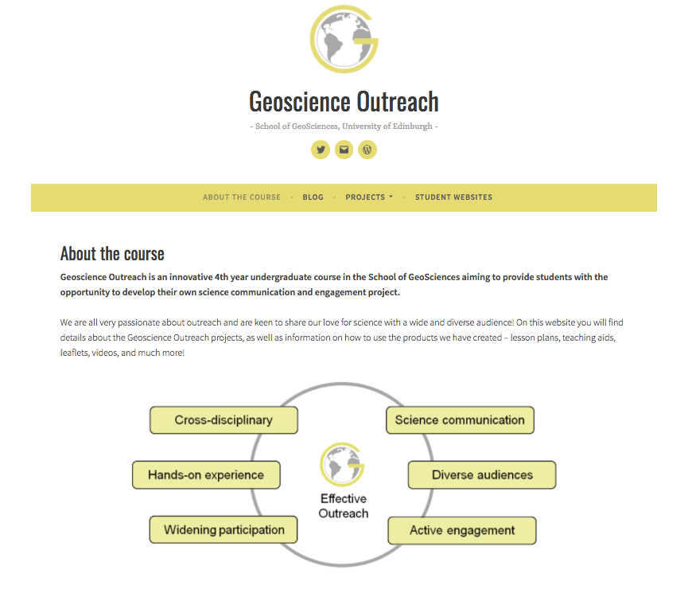
GeoSciences Outreach Course, https://www.ed.ac.uk/geosciences/undergraduate/geoscience-outreach
Notes:
One fab example of open education and co-creation in the curriculum is the Geosciences Outreach Course. This optional project-based course for final year Honours and taught Masters students, has been running for a number of years and attracts students from a range of degree programmes including Geology, Ecological and Environmental Sciences, Geophysics, Geography, Archaeology and Physics. Over the course of two semesters, students design and undertake an outreach project that communicates some element of their field. Students have an opportunity to work with a wide range of clients including schools, museums, outdoor centres, science centres, and community groups, to design and deliver resources for STEM engagement. These resources can include classroom teaching materials, websites, community events, presentations, and materials for museums and visitor centres. Students may work on project ideas suggested by the client, but they are also encouraged to develop their own ideas. Project work is led independently by the student and supervised and mentored by the course team and the client.

Slide 29





Notes:
This approach delivers significant benefits not just to students and staff, but also to the clients and the University. Students have the opportunity to work in new and challenging environments, acquiring a range of transferable skills that enhance their employability. Staff and postgraduate tutors benefit from disseminating and communicating their work to wider audiences, adding value to their teaching and funded research programmes, supporting knowledge exchange and wider dissemination of scientific research. The client gains a product that can be reused and redeveloped, and knowledge and understanding of a wide range of scientific topics is disseminated to learners, schools and the general public. The University benefits by embedding community engagement in the curriculum, promoting collaboration and interdisciplinarity, and forging relationships with clients.

Slide 30
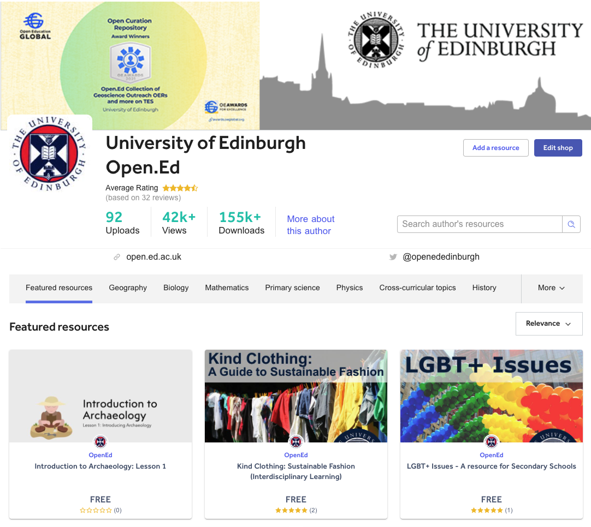
Open.Ed on TES Resources, https://www.tes.com/teaching-resources/shop/OpenEd
Notes:
The Geosciences Outreach course has proved to be hugely popular with both students and clients. The course has received widespread recognition and a significant number of schools and other universities are exploring how they might adopt the model.
A key element of the Course is to develop resources with a legacy that can be reused by other communities and organisations. Open Content Curation student Interns employed by the University’s OER Service repurpose these materials to create open educational resources which are then shared online through Open.Ed and TES where they can be found and reused by other school teachers and learners.

Slide 31
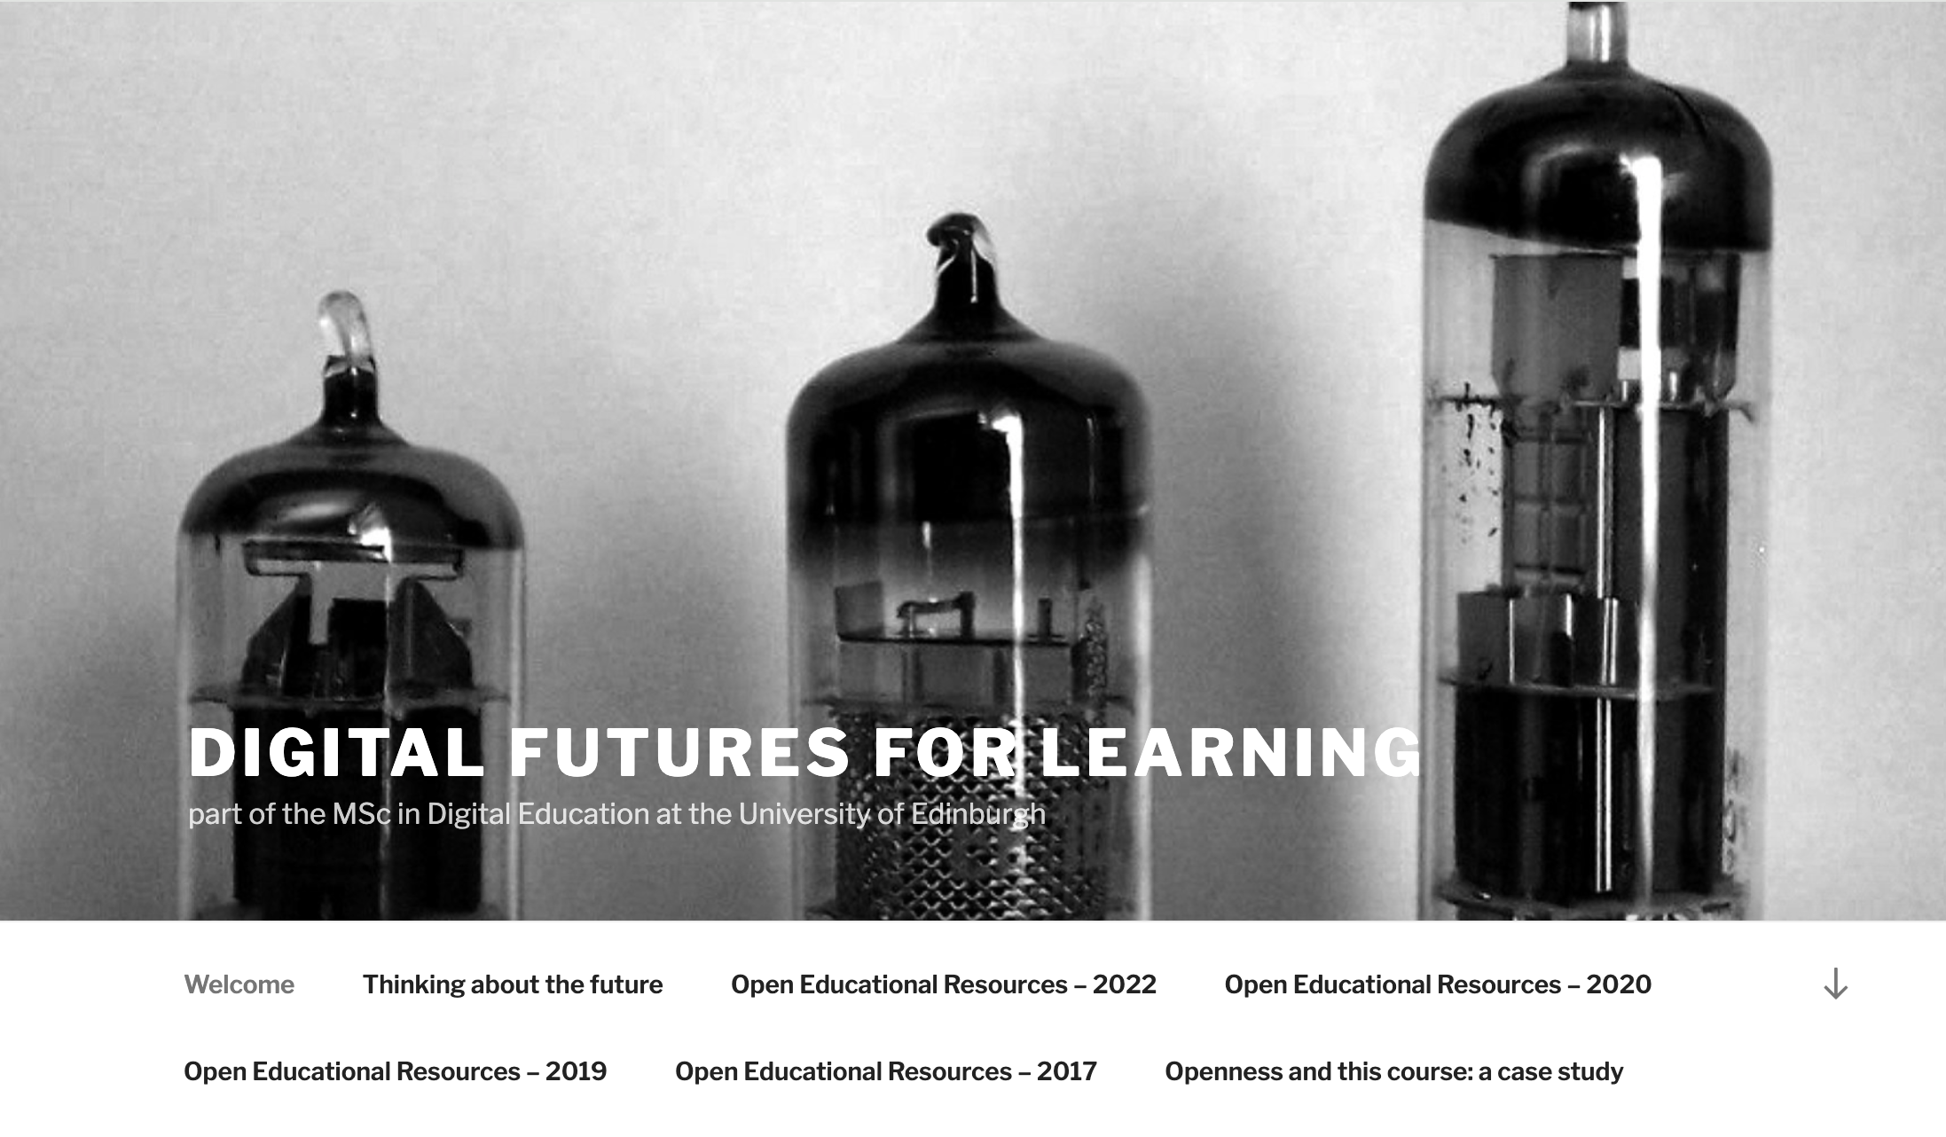
Digital Futures for Learning https://digitalfutures.de.ed.ac.uk/
Old Tech, by Alejandro Polanco, CC BY-NC, on Flickr.
Notes:
Another successful integration of OER assignments into the curriculum is our postgraduate Digital futures for Learning module as part of the MSc in Digital Education.

Slide 32

OER Assignments
Encourage students to critically evaluate the implications of educational trends.
Provide a platform to share their learning.
Provides an opportunity to apply their learning into a tangible re-usable resource with ongoing value & legacy.
INFORMATION by Paul Keller, CC BY 2.0 on Flickr.
Notes:
This course is mostly undertaken by current education professionals and the assignments:

Slide 33
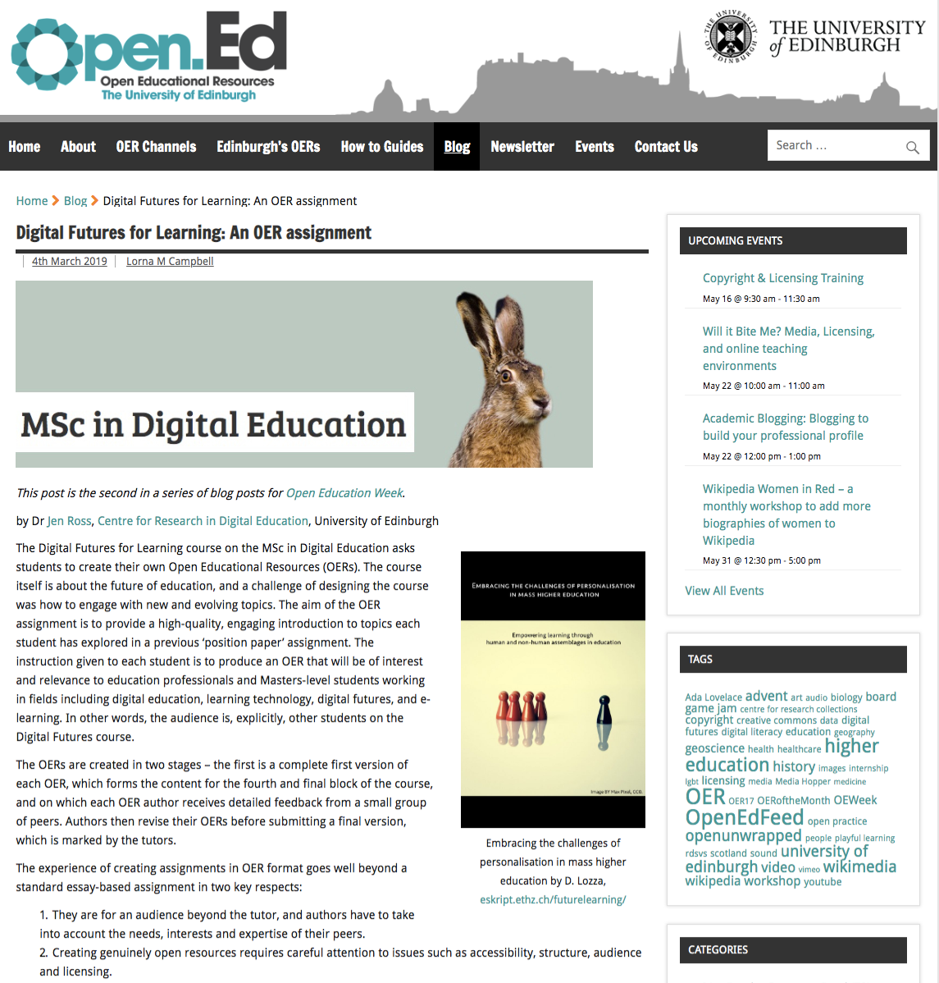
Digital Futures for Learning: An OER assignment,
http://open.ed.ac.uk/digital-futures-for-learning-an-oer-assignment/
Notes:
The course organiser Dr Jen Ross has written an excellent blog post on her reflections of using OER as assignment in the course.

Slide 34
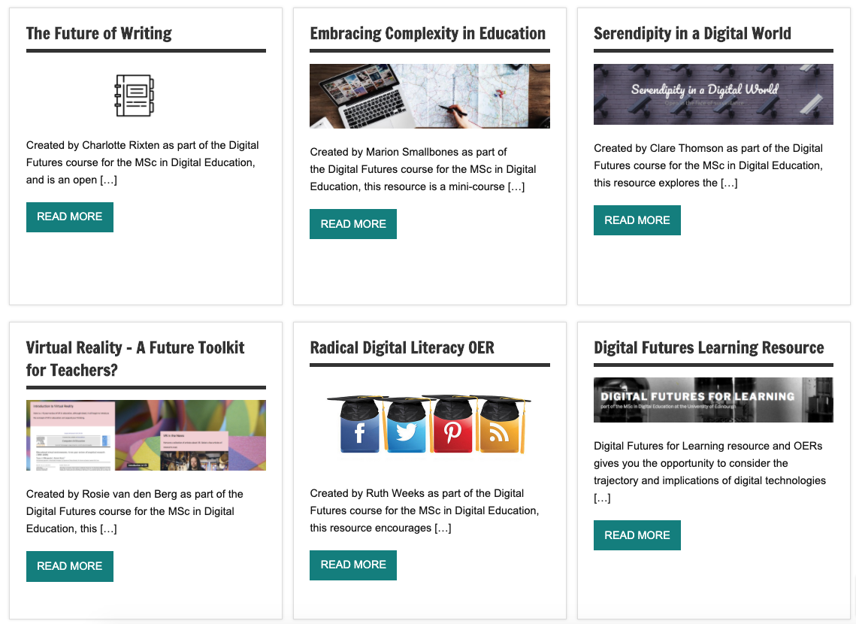
Digital Futures for Learning OERs, https://open.ed.ac.uk/tag/digital-futures/
Notes:
If you’d like to explore some of the resources made by the students you can find them on our Open.ed webpages.
These are just some examples of the way that open education and OER have been integrated into the curriculum here at the University of Edinburgh, and I hope they demonstrate how valuable co-creating open knowledge and open educational resources through curriculum assignments can be to develop essential digital skills, core competencies and transferable attributes. There are many more examples I could share including academic blogging assignments, open resource lists, student created open journals, open textbooks, and playful approaches to developing information and copyright literacy skills

Slide 35
Recommendations
Align support for open education and OER to institutional strategy and global policy drivers, e.g. UNESCO Recommendation on OER, UN Sustainable Development Agenda.
Create a permissive policy environment to encourage staff and students to engage with creation and use of OER.
Provide central services to support development of digital skills, capability, and confidence.
Embed open education in the curriculum through Wikipedia editing and OER creation assignments to development of transferable digital and information literacy skills.
Engage students in the co-creation of learning experiences and OER.
Develop course materials that are open by default, ensuring they are sustainable, accessible and reusable.
Notes:
Wrapping up, looking back at our own experiences our recommendations for sustainable institutional strategic support for OER are:

Slide 36
Further Information
Open Educational Resources (OER) Service https://open.ed.ac.uk/
Open Policies for Learning and Teaching https://open.ed.ac.uk/open-policy-for-learning-and-teaching/
Open Media Bank https://media.ed.ac.uk/channel/Open%2BMedia%2BBank/
Short Online Courses https://www.onlinecourses.ed.ac.uk/
GeoScience OERs https://www.tes.com/teaching-resources/shop/OpenEd
Digital Futures for Learning https://digitalfutures.de.ed.ac.uk/
  Digital Futures for Learning OERs https://open.ed.ac.uk/tag/digital-futures/
  Digital Futures for Learning: An OER Assignment https://open.ed.ac.uk/digital-futures-for-learning-an-oer-assignment/

Slide 37
Stephanie Charlie Farley
Stephanie.Farley@ed.ac.uk
This presentation is licensed CC BY 4.0, University of Edinburgh, unless otherwise indicated.

